Slide 1
California Housing Metrics
Sanket Detroja
Alekhya Aakula

Slide 2
CONTENTS
Abstract
Verifying of the input data and their minor editing.
Created (and further verified) a number of calculated features.
A test sample is selected from the initial data set for subsequent testing of the models.
Pipeline created.
Trained two models on different feature sets.
Calculate Metrics

Slide 3
Abstract
Using California Housing Data, we are trying to describe difference of full set of feature results and only numerical data sets.
Trained two models: a) On the entire input feature set; b) Without using categorical input features.

Slide 4
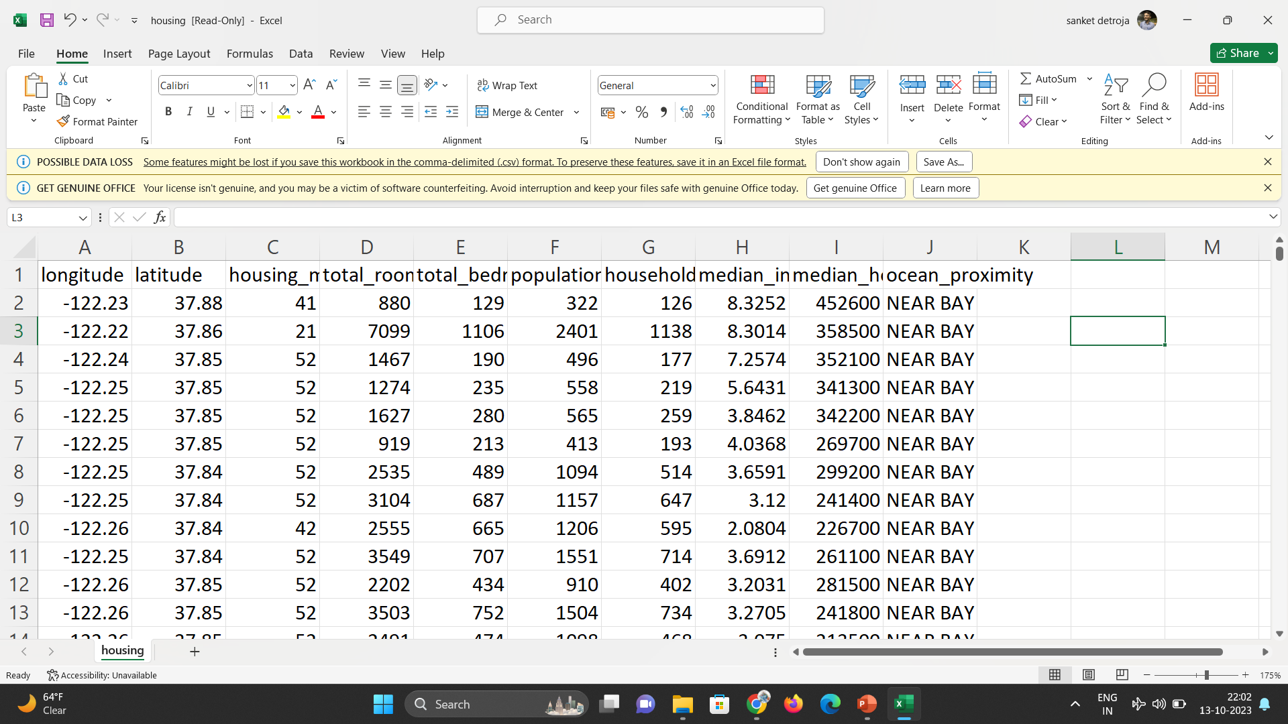

Slide 5
Libraries and Technologies
Technologies:
Jupyter notebook
pyspark
Majorly used libraries in our project:
import pandas as pd
import numpy as np
import pyspark
from pyspark.ml.feature

Slide 6
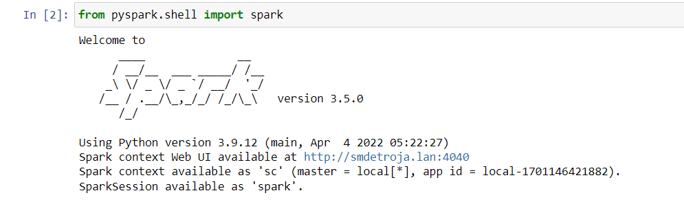

Slide 7
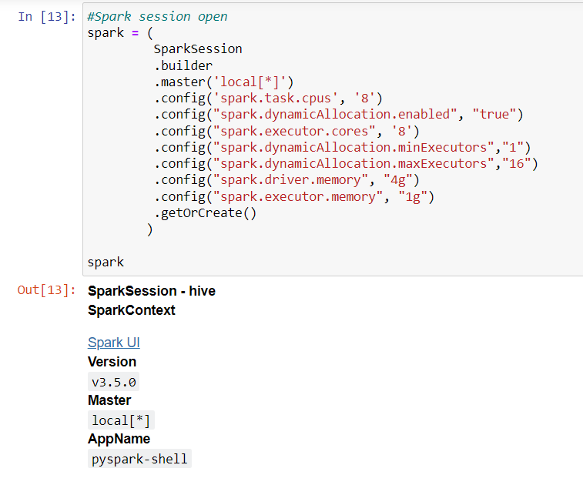
Starting pyspark session

Slide 8
Data Cleaning
There are a small number of missing values in the data (1% of all observations). Missing values are filled with mean (median) values given context

Slide 9
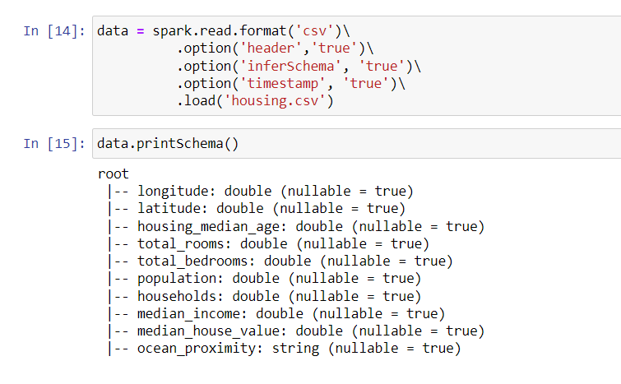

Slide 10
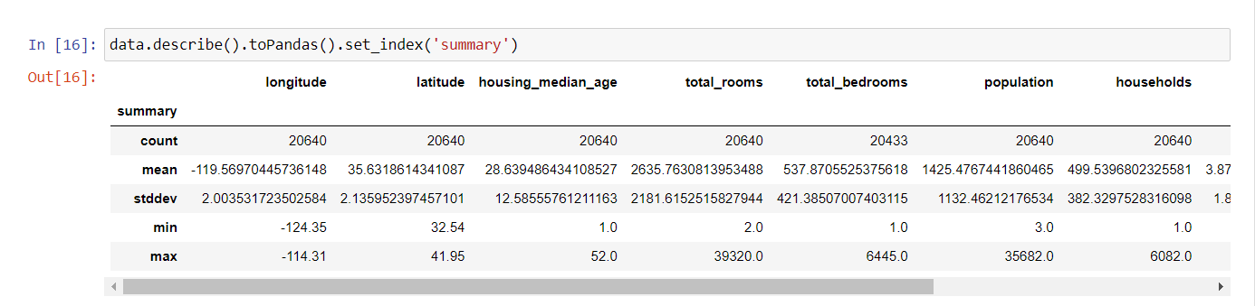

Slide 11
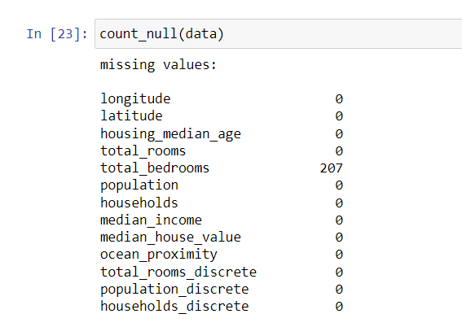

Slide 12
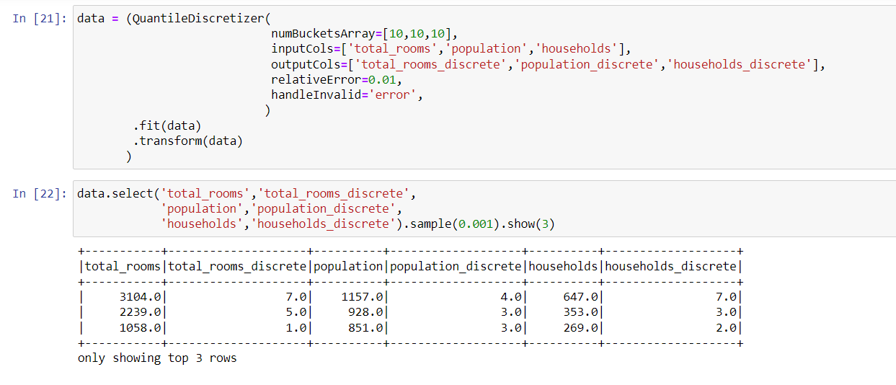
QuantileDiscretizer

Slide 13
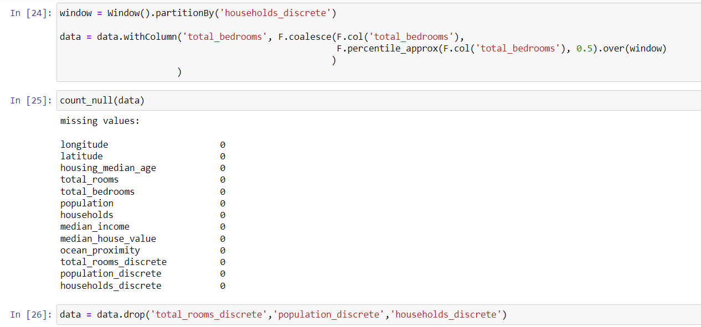

Slide 14
Preparing data for models
A number of features based on arithmetic operations have been created and tested.
The target variable and features are selected.
A test sample was selected from the initial data set for subsequent testing of the models.

Slide 15
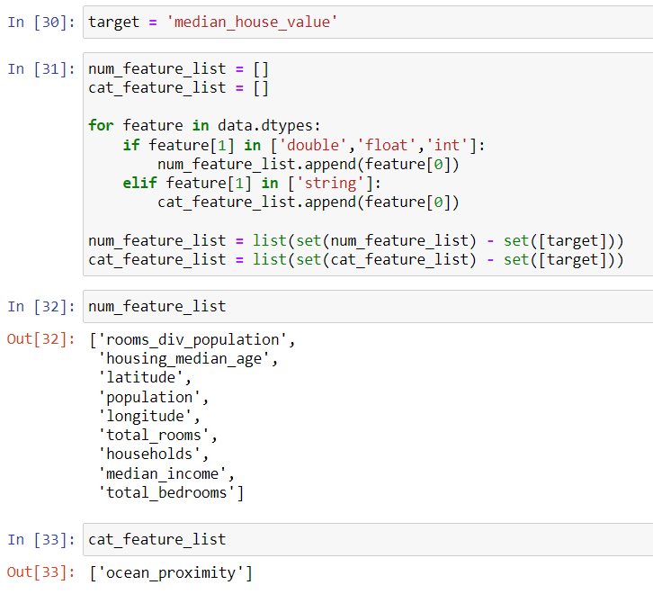

Slide 16
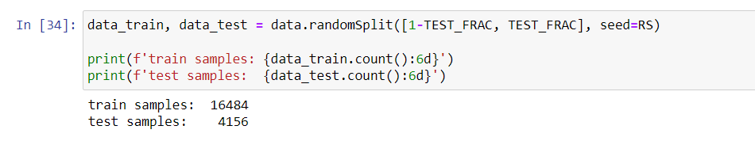

Slide 17
Pipeline
The developed pipeline includes:
Creating numerical features
Creating categorical features
Fitting of all features in a single pipeline using linear regression with all features and without categorical features.

Slide 18
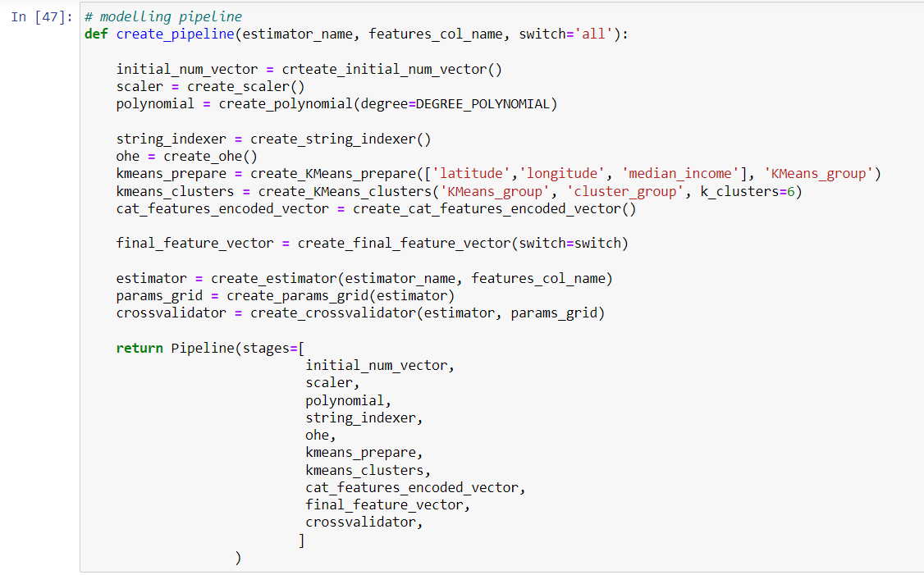

Slide 19
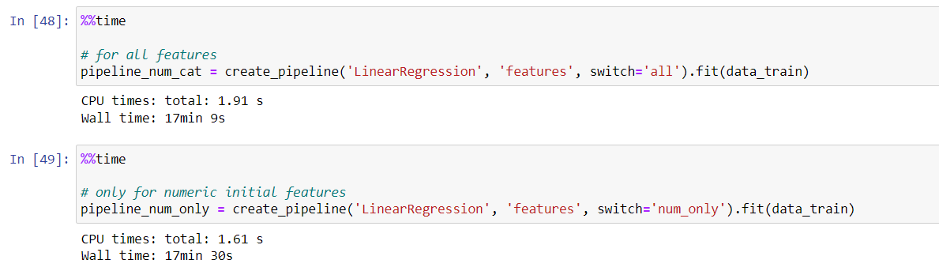

Slide 20
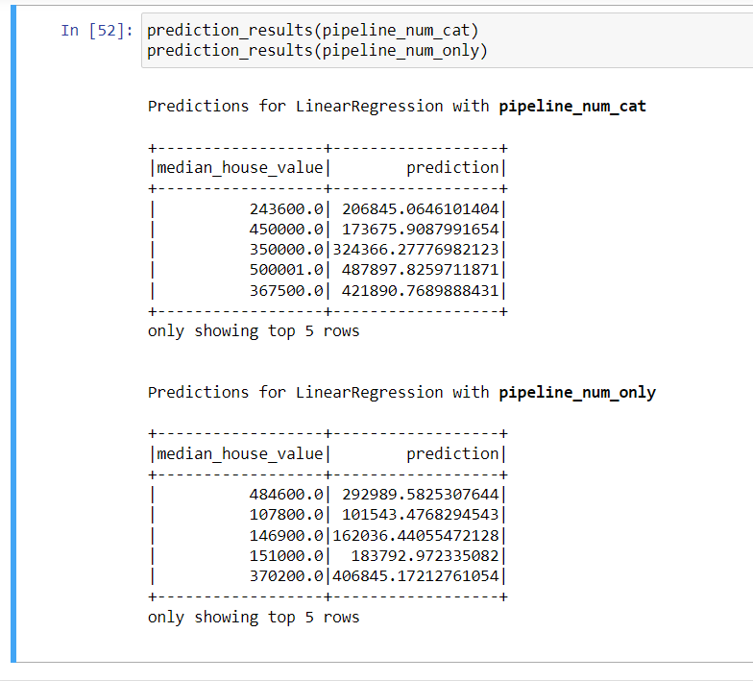

Slide 21
Metrics Terms that we used
R2 (R-squared): A measure of how well the model explains the variance in the data. It ranges from 0 to 1, where 1 indicates a perfect fit.
RMSE (Root Mean Squared Error): A measure of how well the model predicts the actual values. It represents the average difference between predicted and actual values.
MAE (Mean Absolute Error): Another measure of how well the model predicts the actual values. It represents the average absolute difference between predicted and actual values.

Slide 22
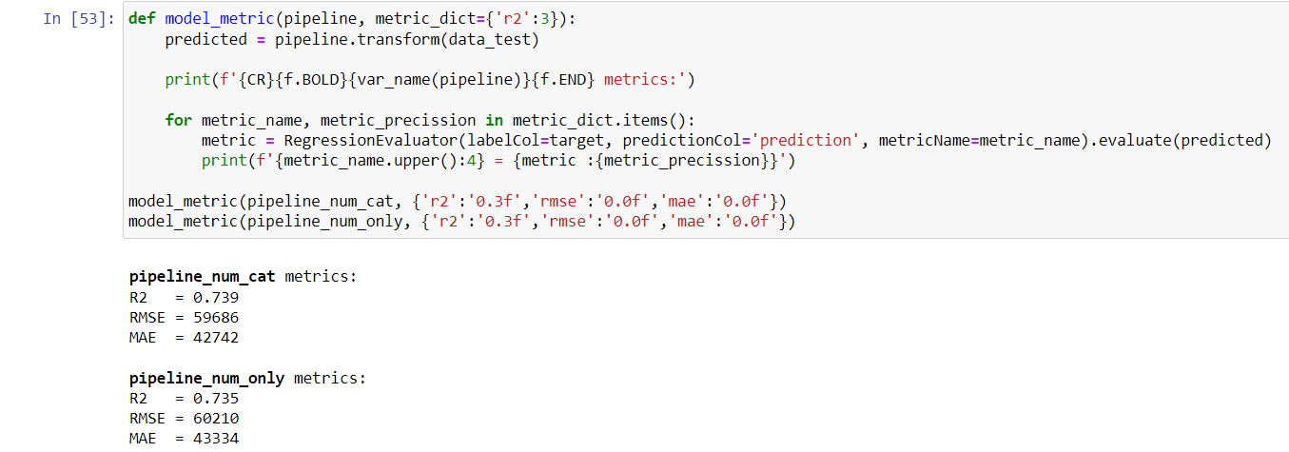
Summarizes the performance of a model for predicted by three evaluation metrics (R2, RMSE, MAE) in a specific format

Slide 23
Descriptive results
Trained two models: a) on the entire input feature set; b) without using categorical input features.
The parameters of the created models were evaluated: a) based on the results of; b) on a test data set.
The model on the full set of features showed a higher result than the model without the use of input categorical features. But the difference is small.

Slide 24
Thank you

